Slide 1
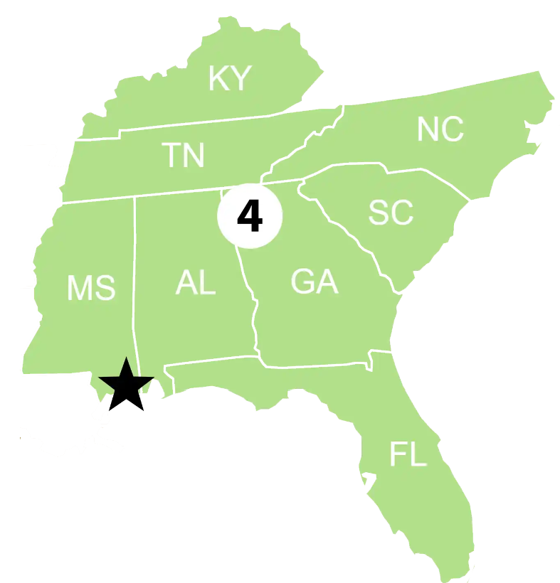
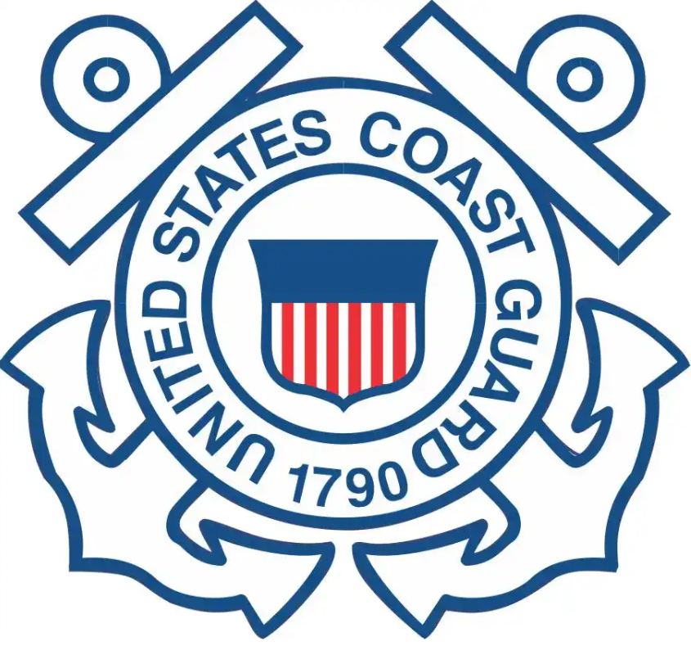
Sector Key West
Federalized cases: Seven Federal Projects, abandoned vessels, fires, abandoned fuel containers and migrant chug.
Notable cases or engagements: MST2 Hayden Hunt presented his paper on alternate response techniques at the IOSC conference in New Orleans. He was also presented the Wallace Award for 2022 at the conference.
3 biggest RRT-related concerns in your AOR:
1. The Florida Keys have not needed any support from the RRT in recent history. Every time we have communicated with the RRT we have received the needed support.
2.
3.

